Slide 1






Slide 2

"Loans can be an engine of progress, or a pathway to ruin; the key lies in wisdom and responsibility."
Banks face several challenges in giving loans:
Credit Risk: Assessing borrower creditworthiness accurately and managing potential defaults.
Regulatory Compliance: Navigating complex and evolving regulations, which can be costly and time-consuming.
Lengthy Processes: Manual verifications, extensive paperwork, and traditional underwriting lead to slow approvals.
Competition: FinTech's and digital lenders offer faster, more convenient options, pressuring traditional banks.
Technology Adoption: Integrating new technologies like AI for efficiency and improved customer experience is crucial but challenging.
Economic Uncertainty: Fluctuating market conditions and economic downturns impact loan demand and repayment capacity.

Slide 3



Problem Definition
Loan approval prediction poses a unique challenge due to the multifaceted nature of the factors that influence an applicant’s ability to repay a loan. Traditionally, loan officers have relied on a set of criteria—such as credit score, income level, age, and past loan repayment history—when determining the risk associated with lending money to an individual. However, this process often lacks objectivity and is subject to human bias, where subjective interpretations of the data can lead to unfair or inconsistent decisions. Additionally, the sheer volume of loan applications in large financial institutions makes it increasingly difficult for human evaluators to maintain accuracy and efficiency.

Slide 4


Preview
Demographic factors: Age, marital status, education level, and employment status, which often influence an applicant's financial stability and future earning potential. Credit-related factors: Credit score, outstanding debts, and the applicant’s credit history, which are indicative of how reliable an individual has been in repaying previous debts. Financial factors: Monthly income, loan amount, loan term, and debt-to-income ratio, which provide insight into an applicant’s ability to manage additional financial commitments. Behavioral and socio-economic factors: Housing situation, type of employment, and other lifestyle-related information that can impact the applicant’s long-term financial behavior. The traditional approach of loan approval heavily relies on the judgment of loan officers to interpret these factors and make decisions, which can often result in subjective and biased outcomes. The key problem this project seeks to address is automating this decision-making process using machine learning, ensuring that decisions are made based on data-driven insights rather than human judgment alone.

Slide 5
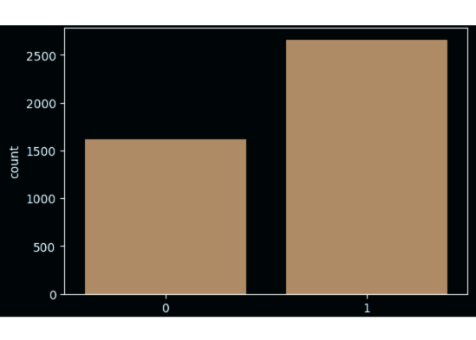


Approved VS Rejected Loans

Slide 6

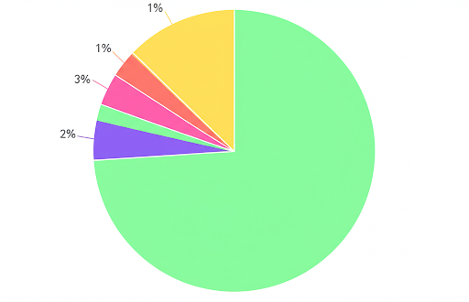


Breakdown of Loan Durations
* The pie chart illustrates the distribution of loan terms, categorized by duration.
* It displays five distinct loan term categories: 2 years, 4 years, 6 years, 8 years, and 10 years.
* Each slice of the pie represents the count of loans for a specific term, with values including 447, 404, 436, 386, and 490.
* The highest number of loans are for the 10-year term (490), while the lowest is for the 6-year term (386).
* All segments are currently depicted in variations of purple, making differentiation challenging without additional labels or distinct colors.

Slide 7


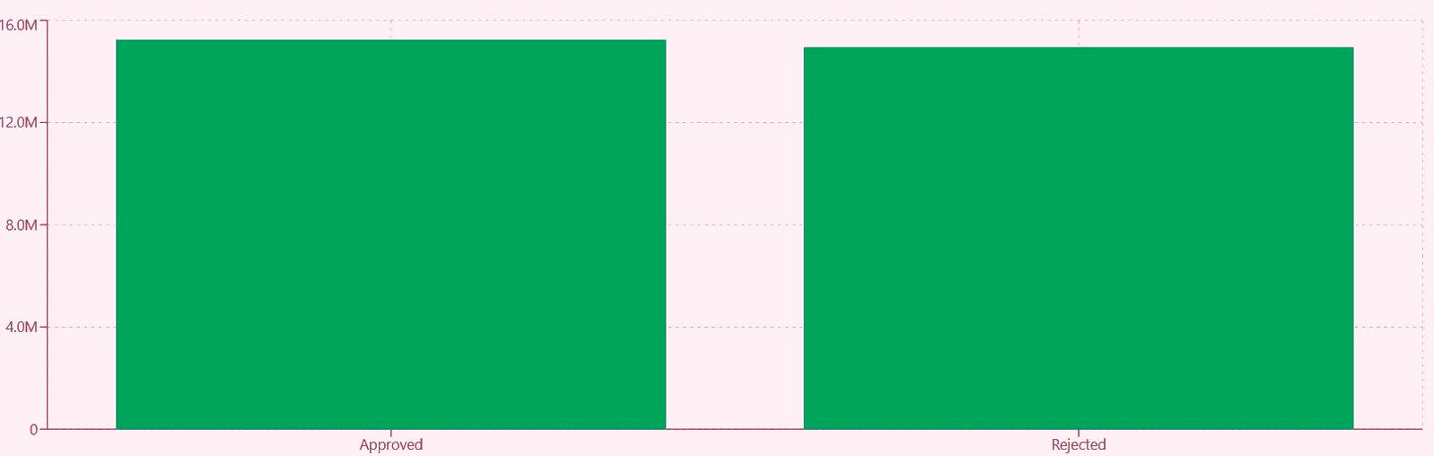
Average Loan By Approval Status

Slide 8
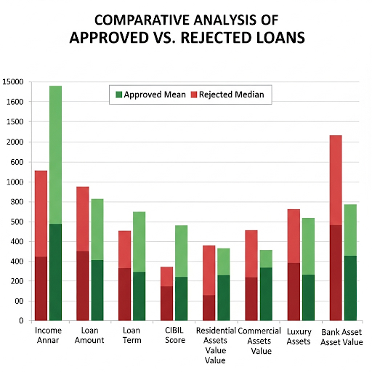

Slide 9
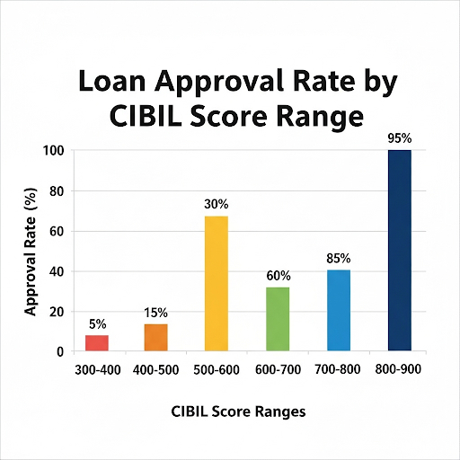

Approval Rates By Cibil Score

Slide 10
Overview Of the Dataset
Dataset Overview: The analysis is based on a comprehensive dataset consisting of 4,269 individual loan applications. Each application includes various financial and personal attributes, specifically income, requested loan amount, CIBIL score, and different categories of asset values (e.g., residential, commercial, luxury, and bank assets).
Overall Approval Rate: Out of the total applications, 62.22% were approved, indicating that roughly two-thirds of applicants successfully secured a loan from this dataset.
Key Influencing Factors: The primary determinants for loan approval were identified as CIBIL score, applicant income, and the requested loan amount. While other features are present, these three emerged as the most impactful in the decision-making process.
CIBIL Score's Critical Role: The CIBIL score is a paramount factor in loan approval. The analysis unequivocally shows that a higher CIBIL score directly correlates with a significantly increased probability of loan approval. This suggests that creditworthiness, as reflected by the CIBIL score, is a central criterion.
CIBIL Score Threshold: A crucial observation is the presence of a notable threshold around a CIBIL score of 600. This implies that applicants with scores above this mark likely experience a considerably higher chance of approval compared to those below it, suggesting a potential cut-off or significant inflection point in the approval process.
Implications (Implicit): The insights suggest that while income and loan amount are important, the CIBIL score acts as a primary filter, indicating that a strong credit history can significantly bolster an application even when other factors might be less ideal.

Slide 11

CONCLUSION
CIBIL Score's Pivotal Role: Confirmed as the most critical factor for loan approval, with a significant positive impact above a clear 600-point threshold.
Demographic Influence: Higher approval rates are observed among graduates and non-self-employed individuals, highlighting the importance of education and stable employment.
Risk-Based Lending: Financial institutions approve larger average loan amounts for lower-risk applicants, demonstrating confidence based on robust profiles.
Optimized Process: This data-driven methodology improves the efficiency, fairness, and accuracy of loan approvals, benefiting both lenders and borrowers.

Slide 12


ALWAYS DIL SE OPEN FOR YOUR FEEDBACK !!!
"Giving poor people access to credit, insurance, and savings can empower them to take control of their lives and build a better future." - Bill Gates

Slide 13

THANKING YOU !! PROJECT BY-SASANT

